Slide 1
Autonomous car
Embedded System
Dr Ahmed Seddik
Eng Meral

Slide 2
Team members:
Amr Khaled 205015
Nardeen Hesham 205074
EL-Sayed Mohamed 205038
Abdelrhman Ahmed 205054
Mohamed Farouk 205011

Slide 3
Abstract:
Our Project idea is about a small car which is controlled by an application through WI-FI Signals.
We used a non-advanced components to create our project, some wires, electronic devices, small chips, etc.

Slide 4
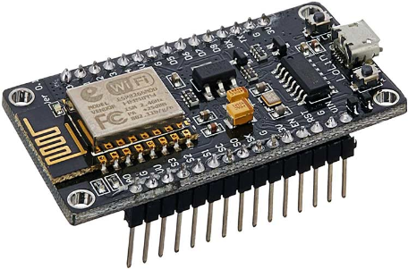
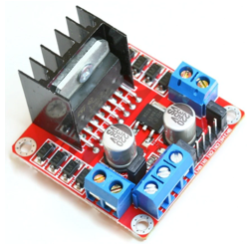
Components:
1- Nodemcu ESP8266: it’s a chip based on ESP-12 module with firmware to access WI-FI Signals
2- L298N Motor Driver: a DC Motor to control with our gear motors, so we can control our car movement, speed.

Slide 5
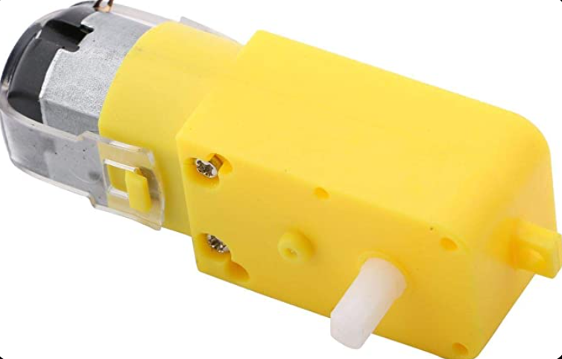
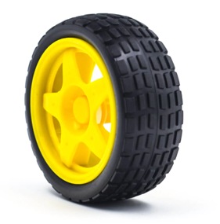
Components:
3- Gear Motors: it’s compatible with the Motor Driver LN298N, it’s an electric motor coupled with a gear train, it uses a DC in our project.
4- Robot Wheel: a normal plastic wheels we use and it’s combined with Gear Motors.

Slide 6
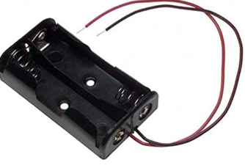
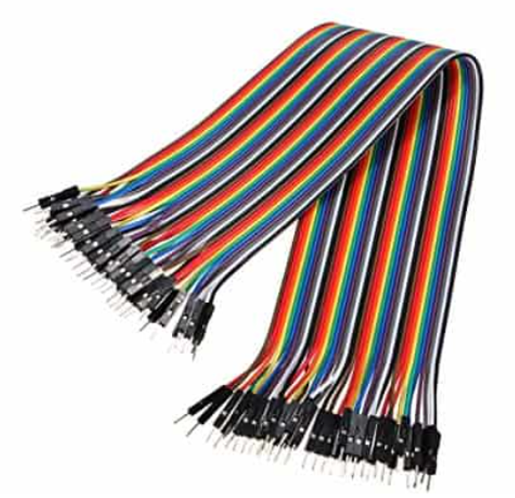
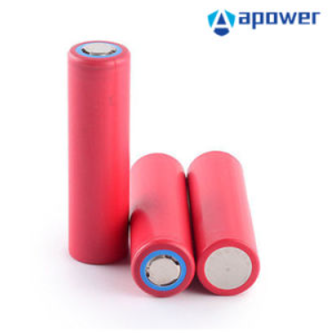
Components:
5- Battery holder: to hold the batteries and it’s connected with the LN298N motor.
6- Jumper Wires: to connect our whole project with motor driver and to have a control over the current flow through the whole car.
7- Li-ion batteries: a simple batteries to provide us with needed current to control the car.

Slide 7
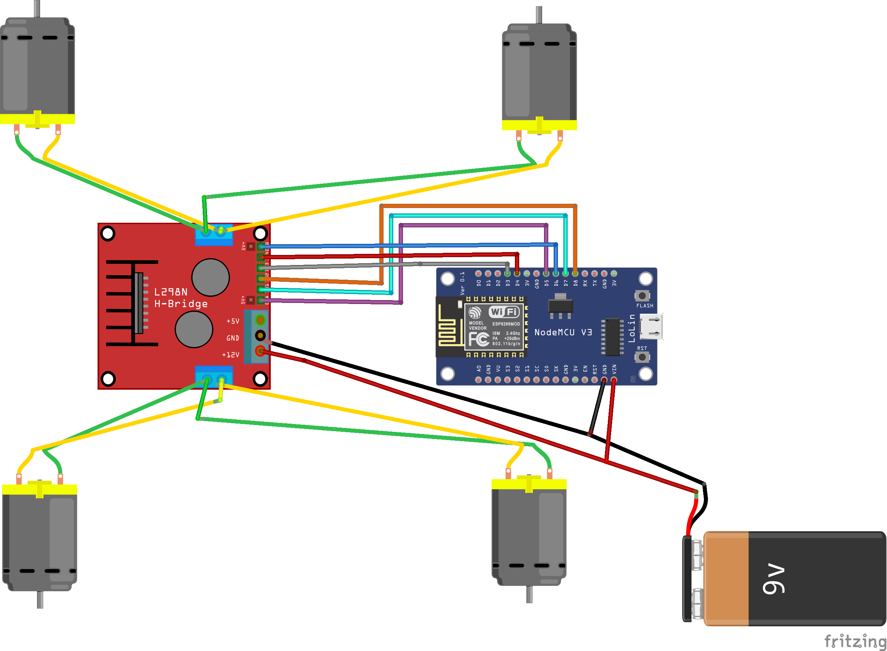
Diagram:

Slide 8
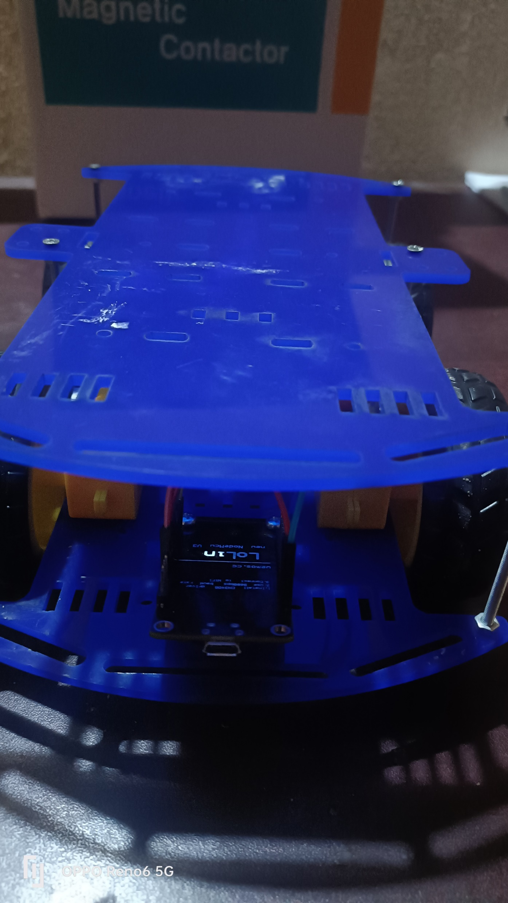
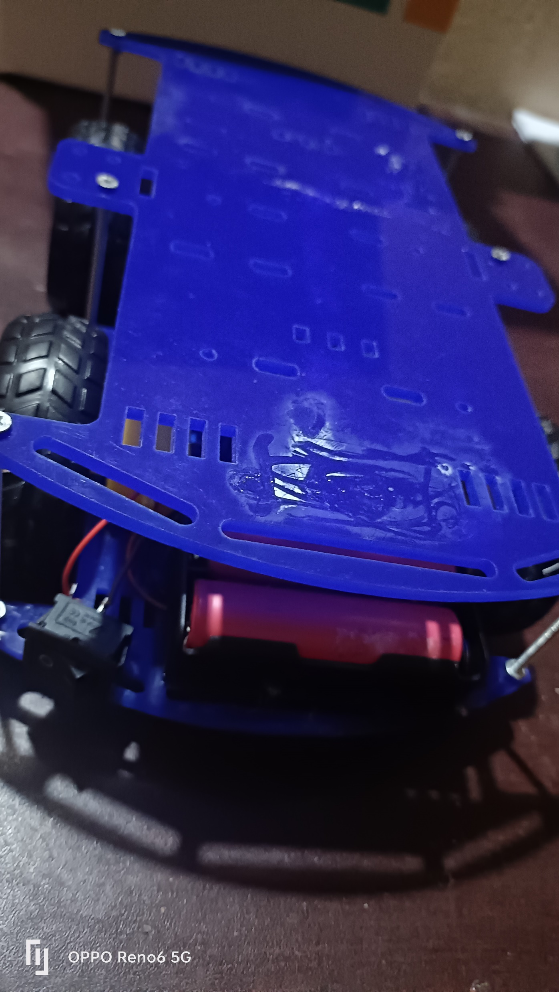
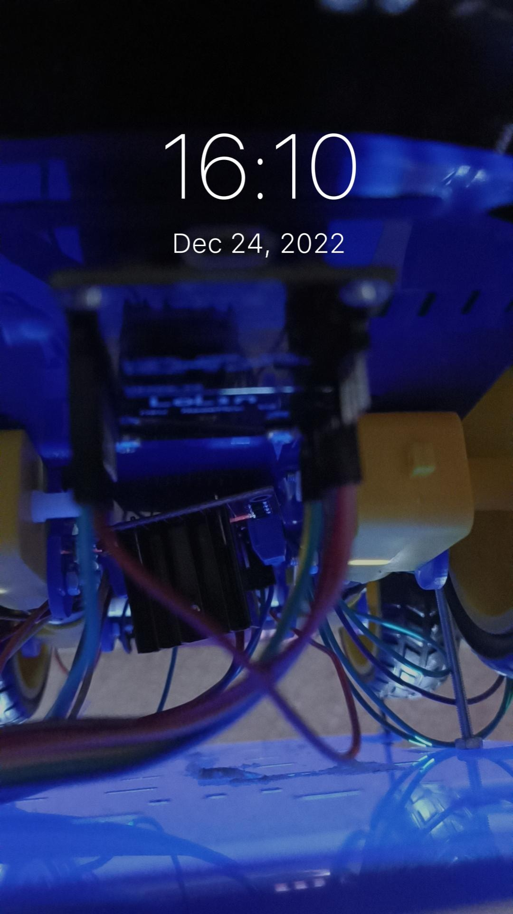
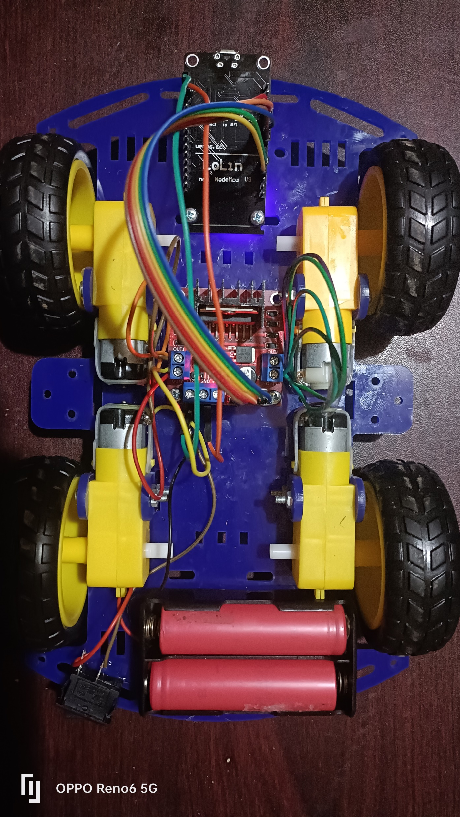
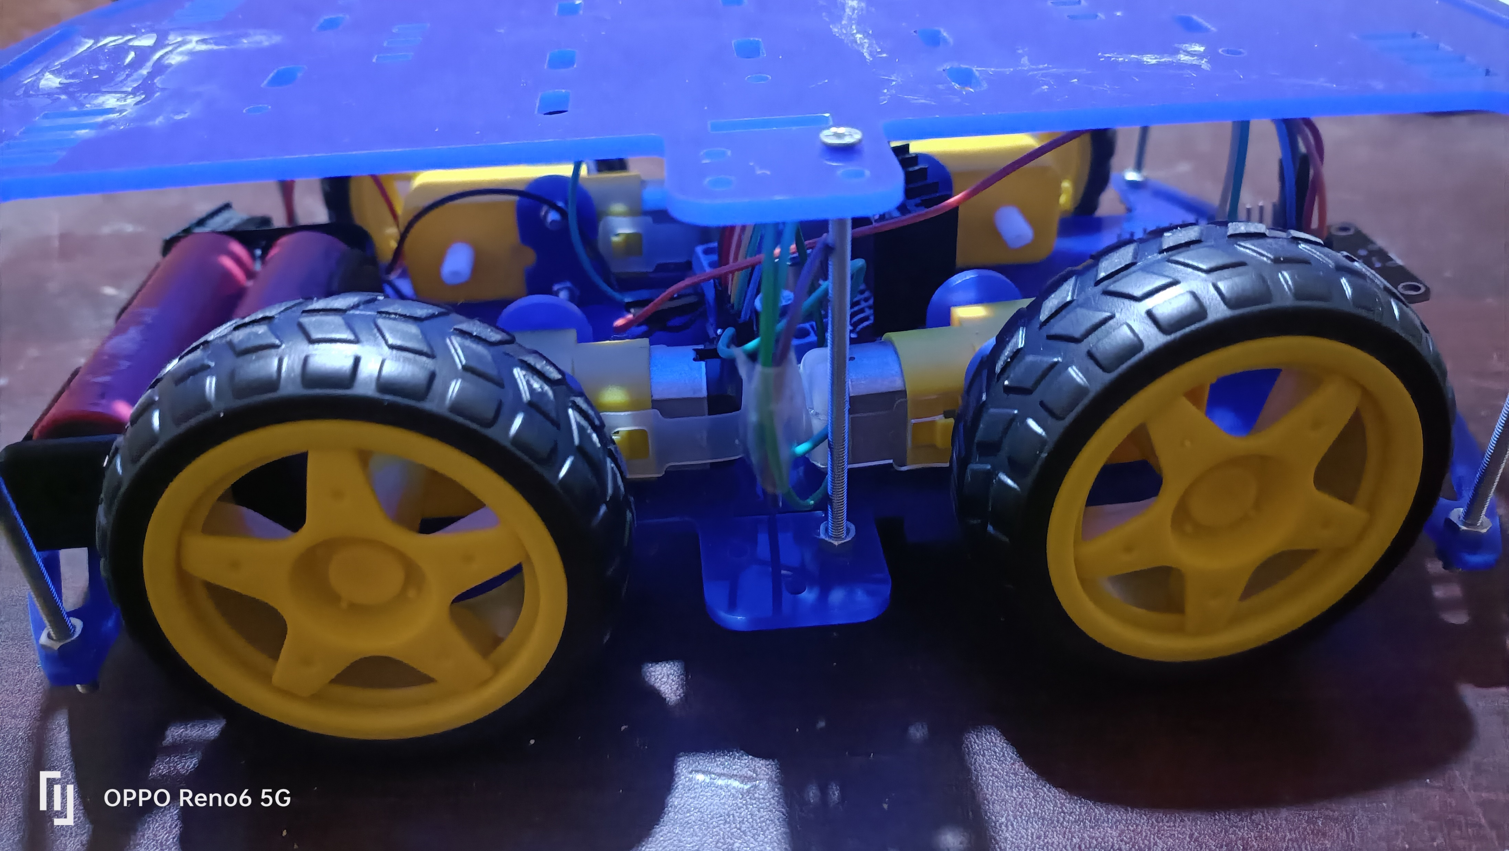
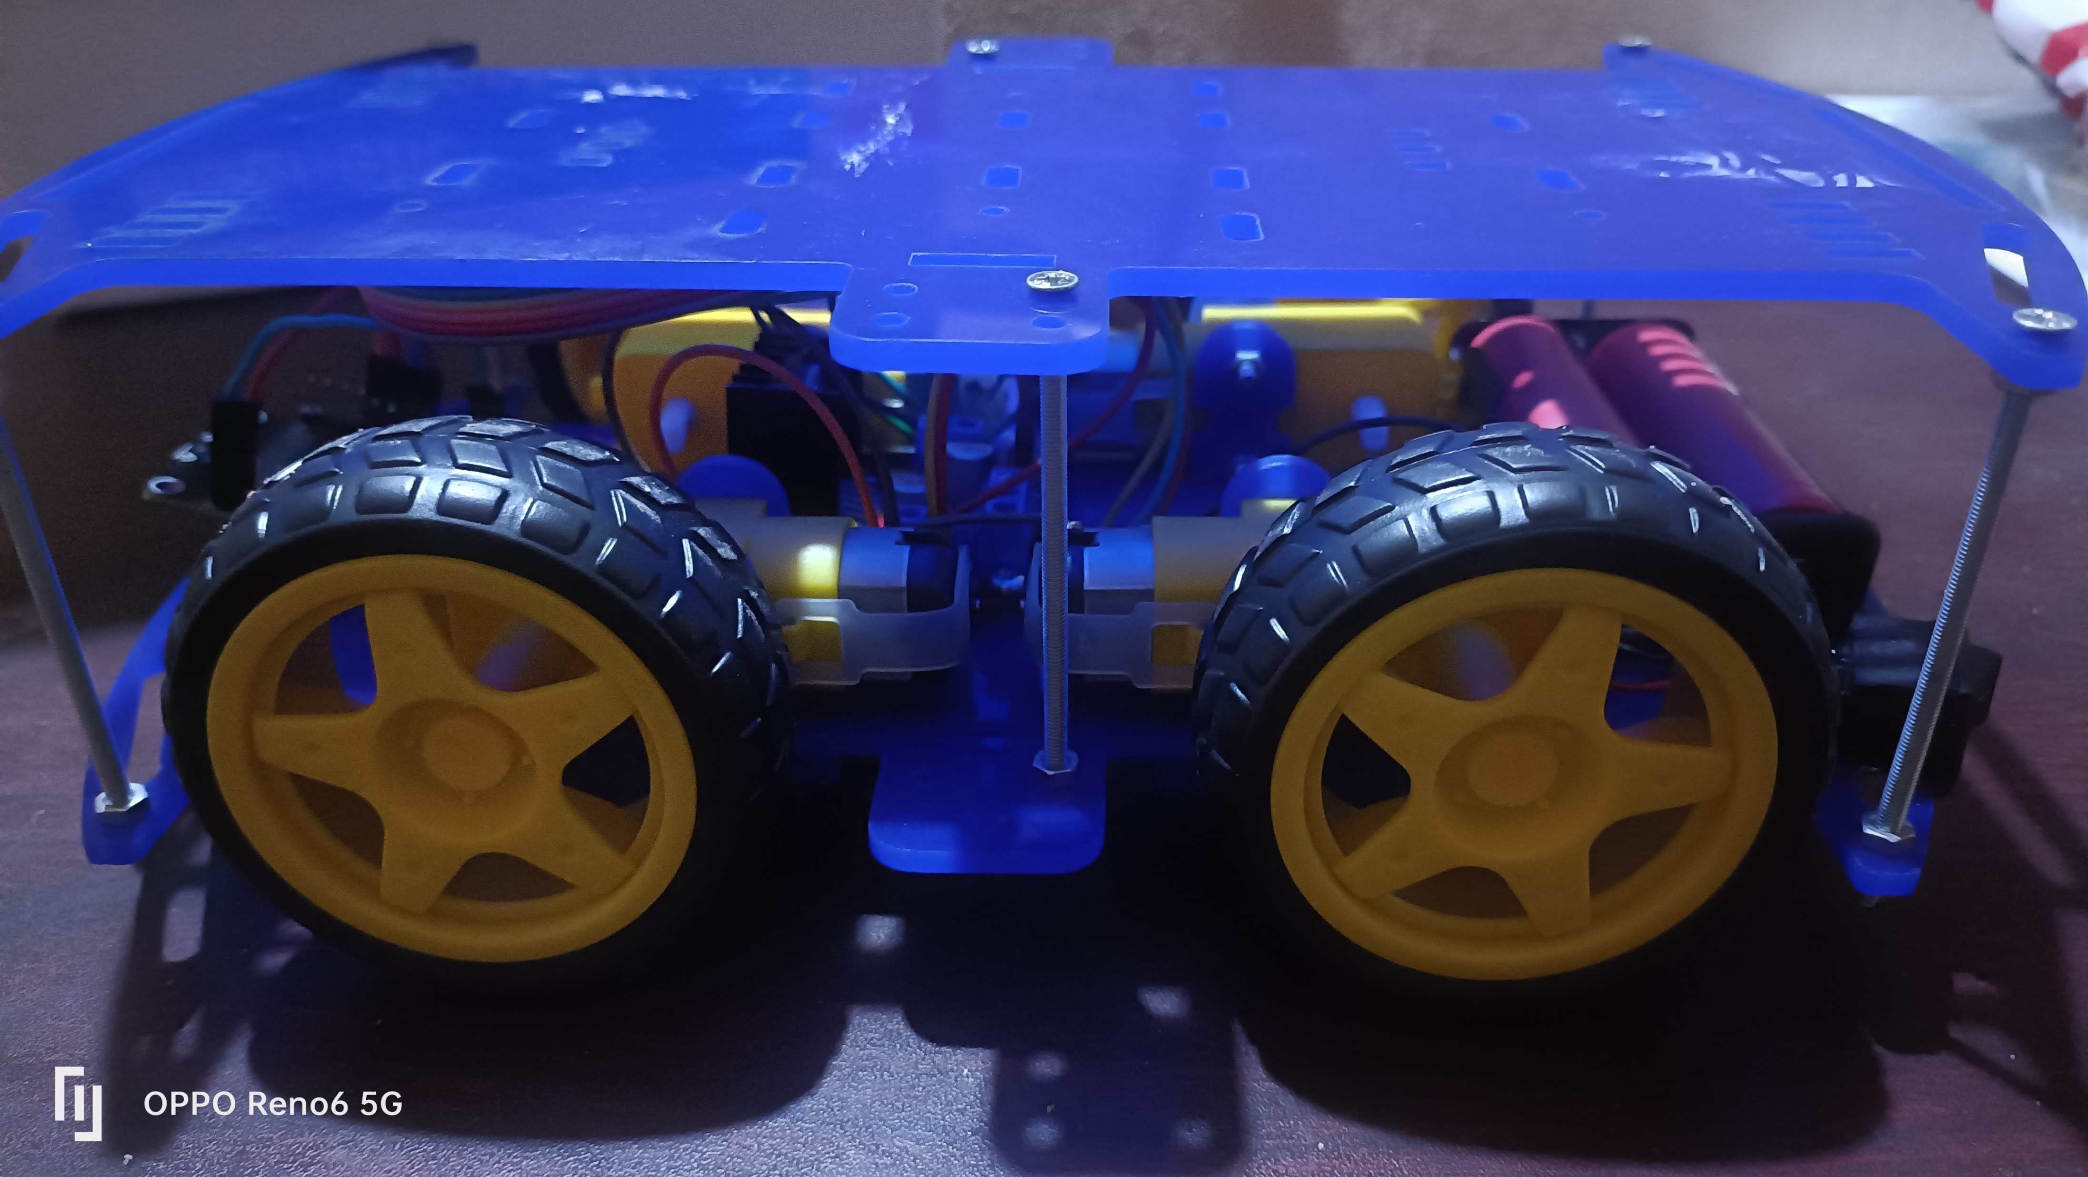
Images:

Slide 9
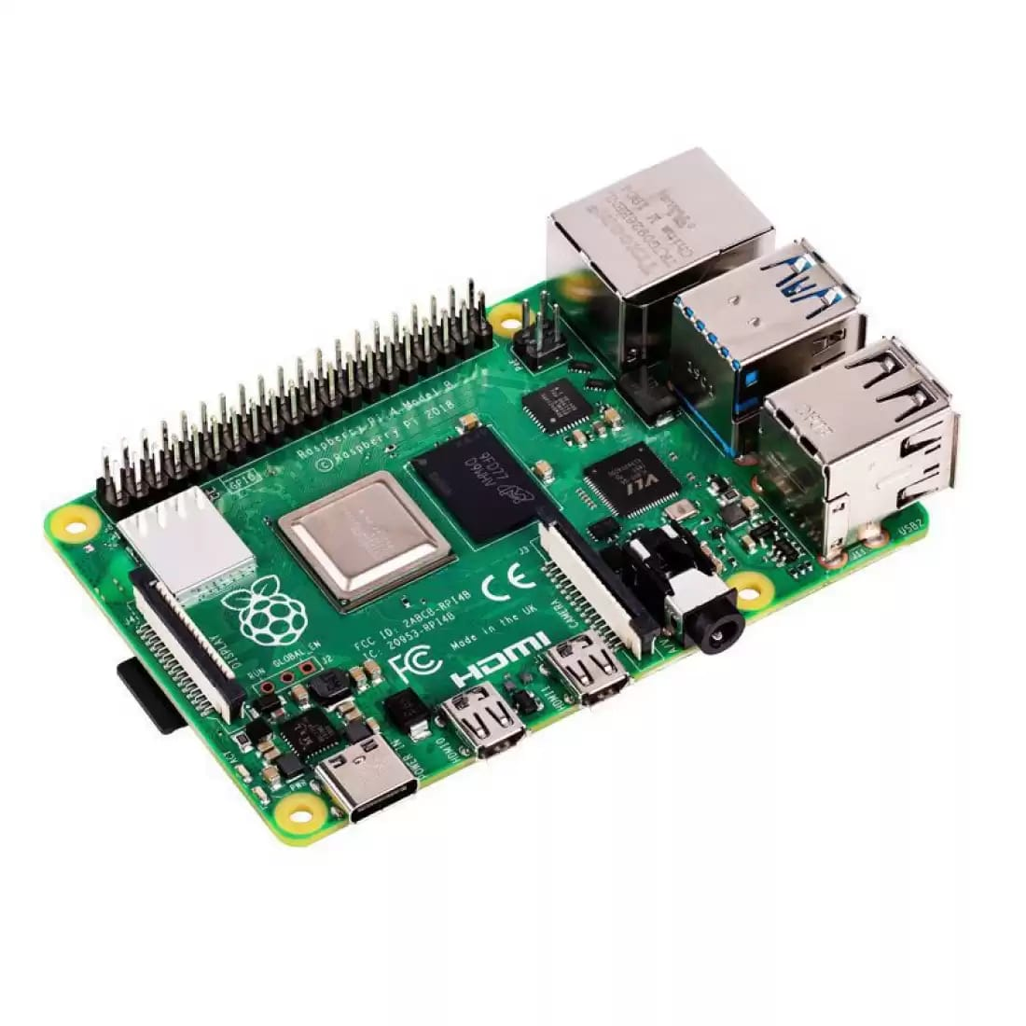
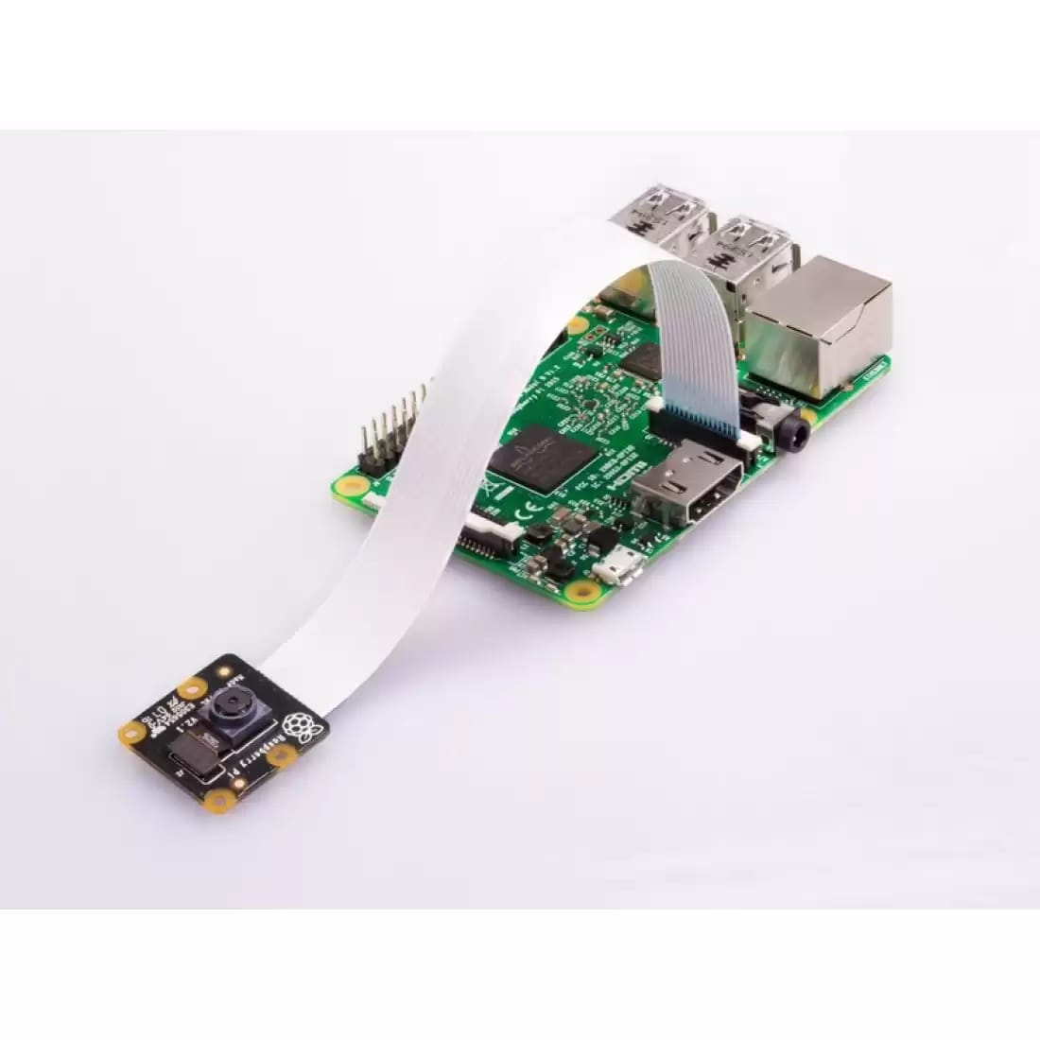
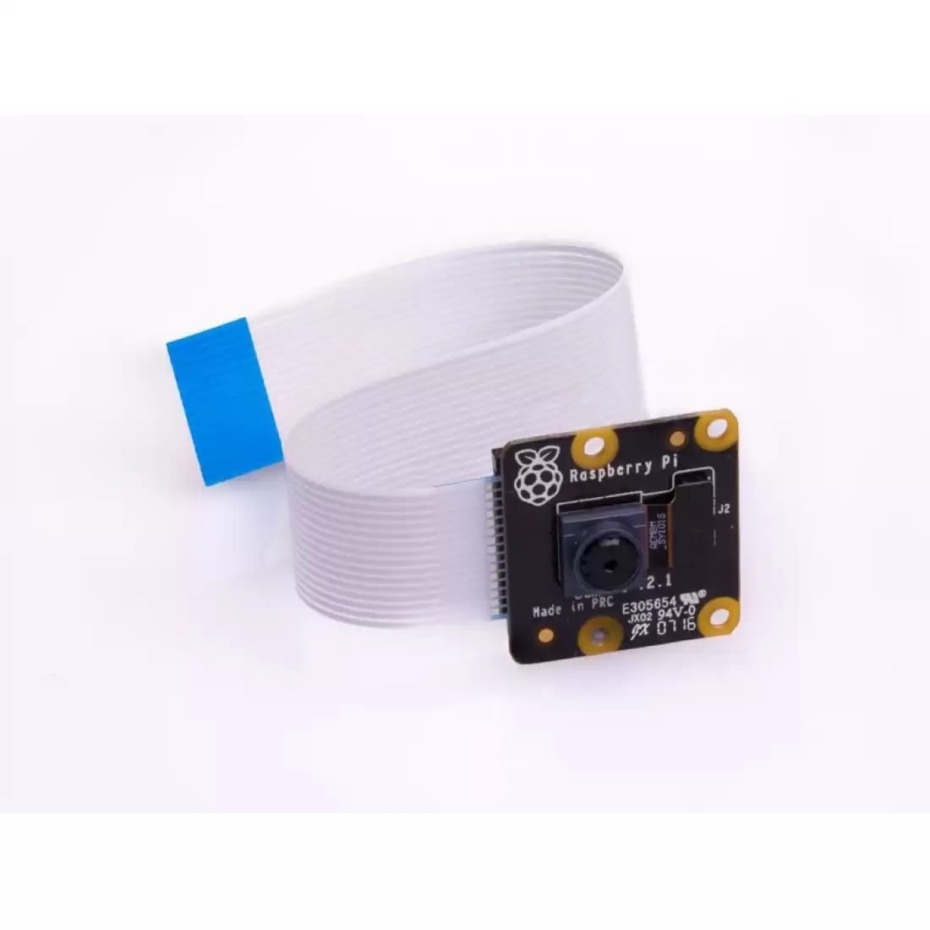
the developed version will be
A self driving car that moves from point A too point B using raspberry processor that is faster than the previous one and can be connected with a camera
Raspberry processor
Raspberry with camera
A camera to be connected to the raspberry

